Slide 1



Slide 2

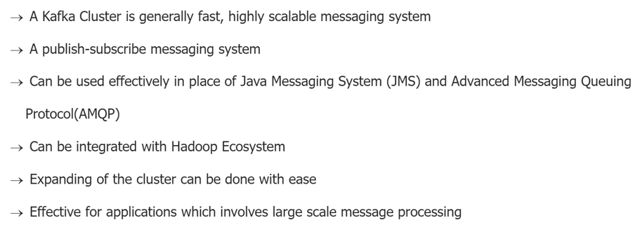
Kafka Cluster

Slide 3
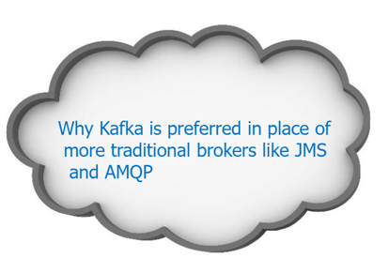
Kafka Cluster

Slide 4
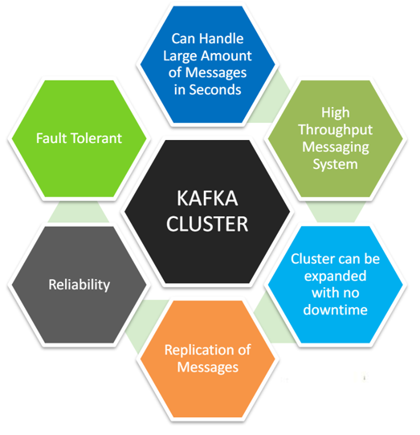
Kafka Cluster - Advantages

Slide 5
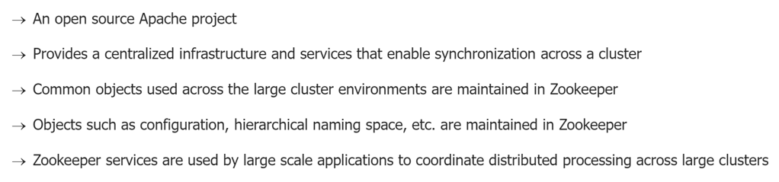
Zookeeper

Slide 6
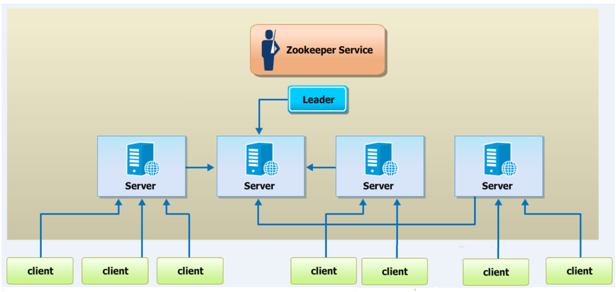
Zookeeper Service

Slide 7
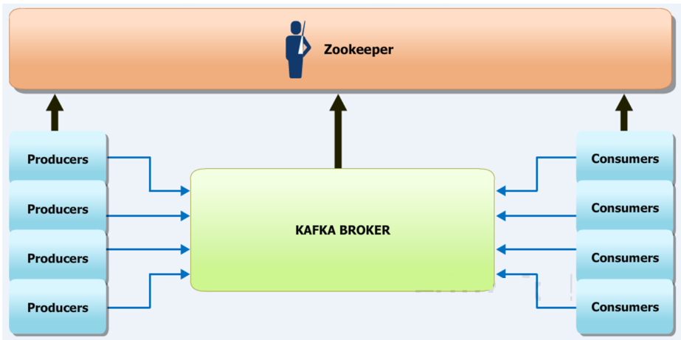
Kafka Cluster and Zookeeper

Slide 8
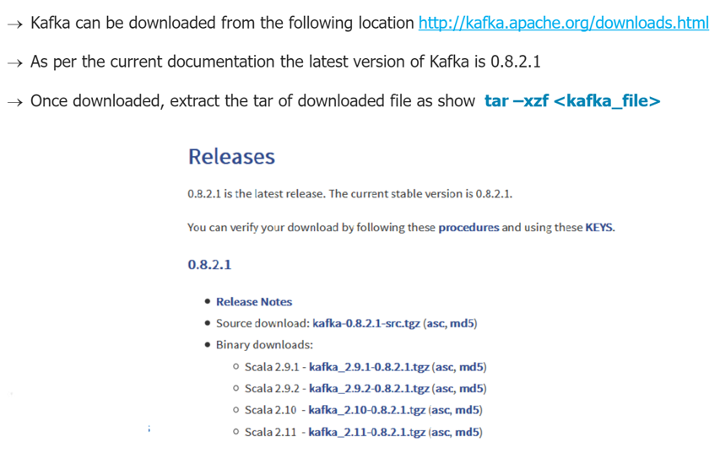
Installing Kafka

Slide 9
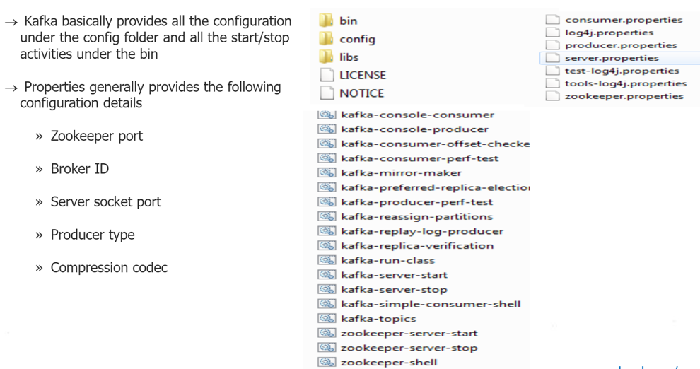
Kafka Folder Structure

Slide 10
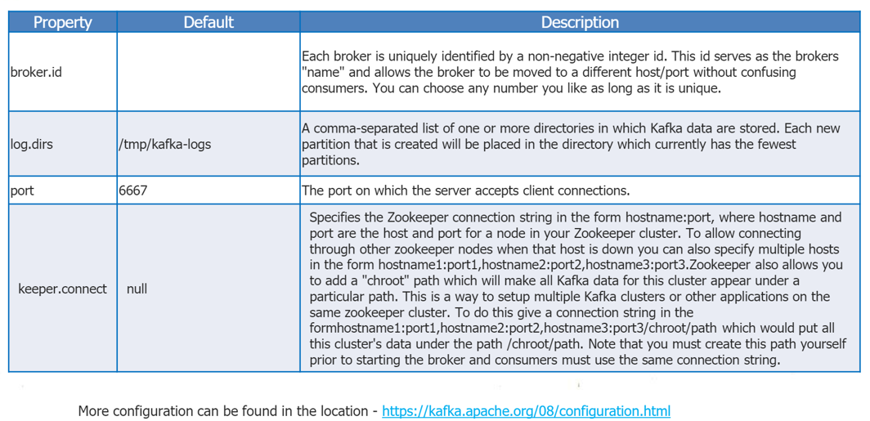
Kafka Configuration

Slide 11
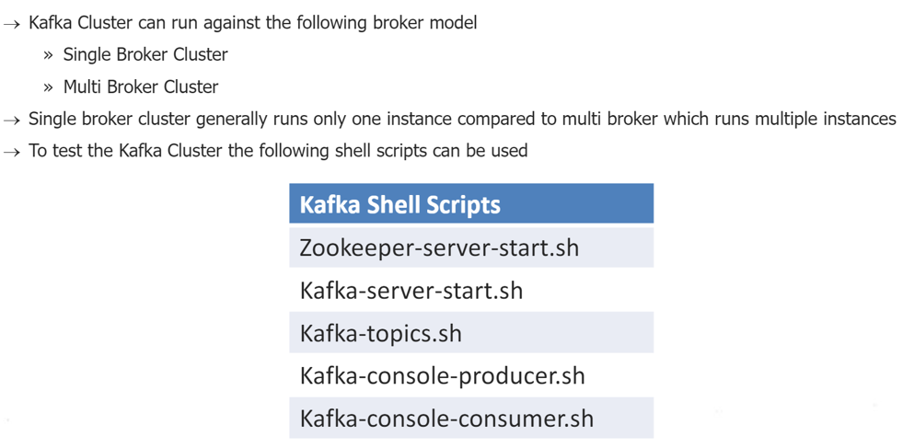
Testing Kafka Cluster

Slide 12
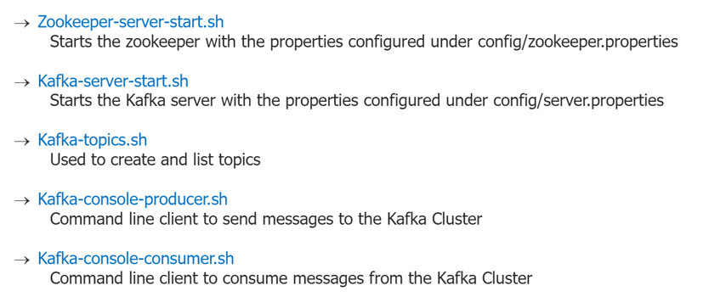
Testing Kafka Cluster

Slide 13
Testing Kafka Cluster

Slide 14
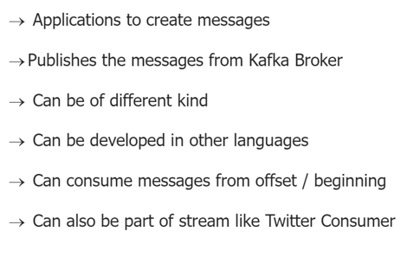
Kafka Producer

Slide 15
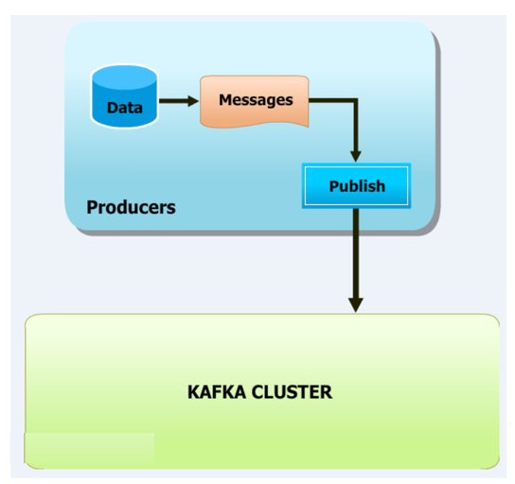
Kafka Producer - Broker

Slide 16
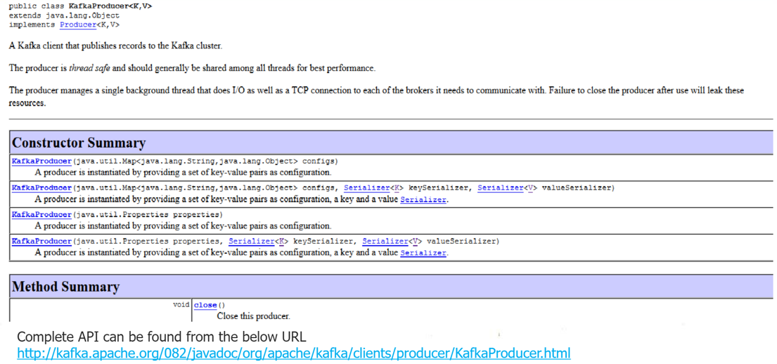
Kafka Producer API

Slide 17
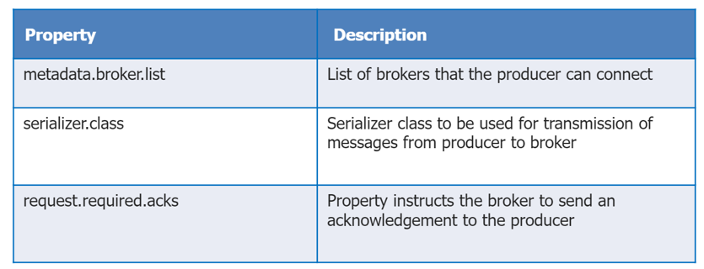
Kafka Producer Properties

Slide 18
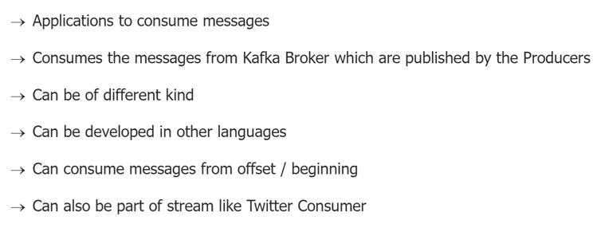
Kafka Consumer

Slide 19
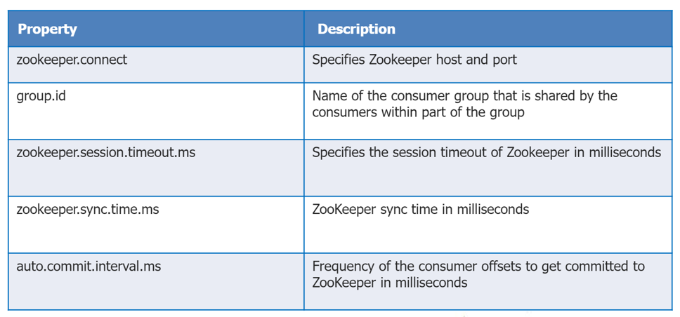
Kafka Consumer - Properties

Slide 20
Kafka Consumer - Properties

